Slide 1

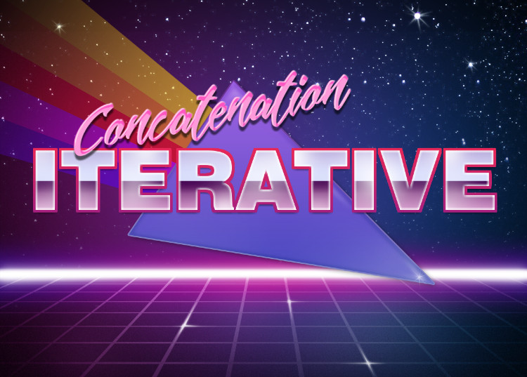
Mark Daniel g. Dacer

Slide 2

String Concatenation
String Concatenation Forms A New String That Is The Combination Of Multiple Strings

Slide 3
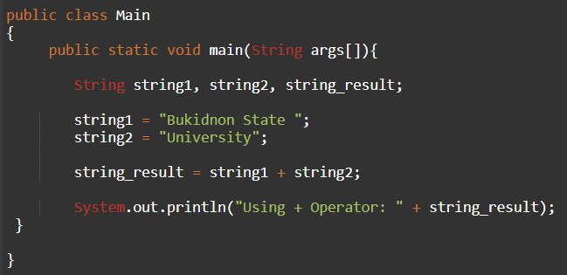
Using + Operator

Slide 4
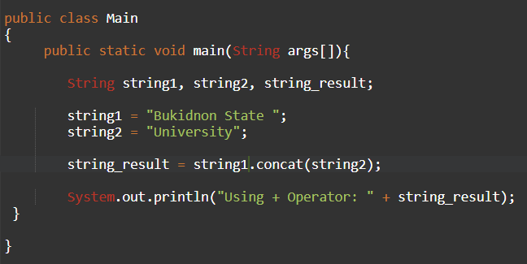
Using concat() method
String concat() method concatenates the specified string to the end of current string

Slide 5
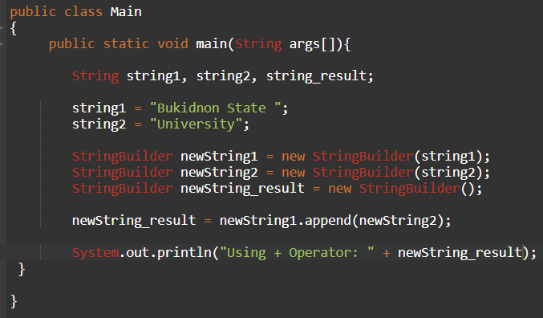
Using StringBuilder Class
String concatenation is implemented through the StringBuilder (or StringBuffer) class and it's append method. String concatenation operator produces a new String by appending the second operand onto the end of the first operand.

Slide 6
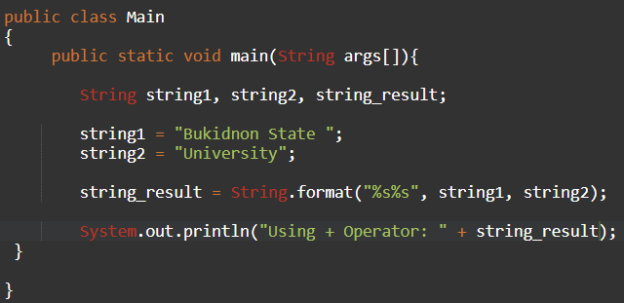
Using format() method
String.format() method allows to concatenate multiple strings using format specifier like %s followed by the string values or objects.

Slide 7

Looping
In computer programming, loops are used to repeat A block of code. For example, if you want to show A message 100 times, then rather than typing the same code 100 times, you can use A loop.

Slide 8
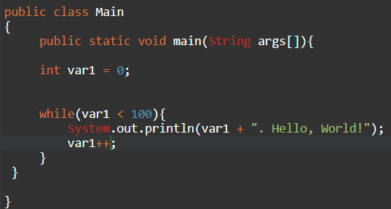
While loop
Java while loop is used to run a specific code until a certain condition is met.

Slide 9
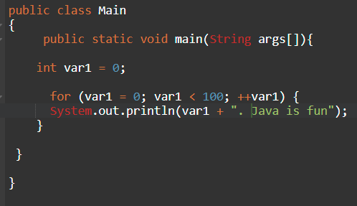
For Loop
Java for loop is used to run a block of code for a certain number of times.

Slide 10
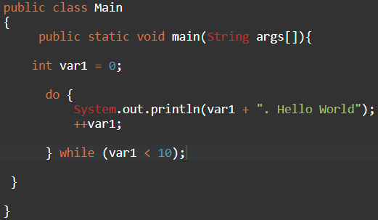
Do While Loop

Slide 11
Additional Learning Links
For Statement - https://docs.oracle.com/javase/tutorial/java/nutsandbolts/for.html
Do & While Statement - https://docs.oracle.com/javase/tutorial/java/nutsandbolts/while.html
Java Strings - https://docs.oracle.com/javase/7/docs/api/java/lang/String.html

